Slide 1
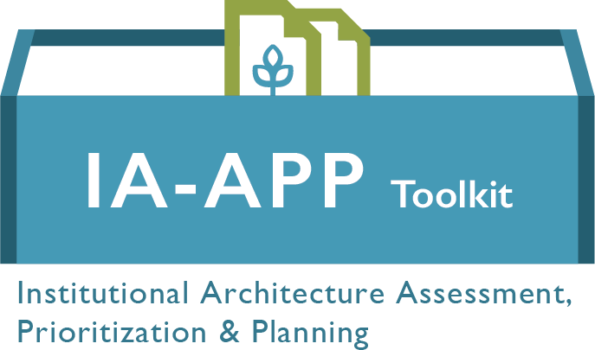

Slide 2
Introduction
The purpose of this slide deck is to serve as a step-by-step guide for Ministries of Agriculture to prepare for and undertake the IA-Assessment, Prioritization & Planning (IA-APP) to improve a country’s institutional architecture for improved agricultural policy and outcomes.
The IA-Assessment, Prioritization & Planning toolkit is a suite of customizable tools to facilitate a multi-stakeholder process and collaborative decision-making to assess a country’s IA and design a plan to strengthen it. The process empowers stakeholders to collectively identify priority issues and co-develop solutions for strengthening inclusive, evidence-based policy change.
Institutional architecture (IA) is the set of institutions, their relationships and performance that determine a country’s capacity to undertake transparent, inclusive, predictable and evidence-based policy change. The IA Framework consists of 6 elements essential for an effective policy process:
Guiding Policy Framework
Policy Development and Coordination
Inclusivity and Stakeholder Consultation
Evidence-based Analysis
Policy Implementation
Mutual Accountability
This framework aligns with the commitments and principles of the African Union’s (AU) Comprehensive Africa Agriculture Development Program (CAADP) and the Busan Partnership for Effective Development Cooperation.

Slide 3
The IA-APP Process in Support of Country & CAADP Processes
The IA-APP process is intended to supplement existing national and regional processes for policy change, and the African Union’s (AU) Comprehensive Africa Agriculture Development Programme (CAADP). CAADP countries commit to a planning and implementation process involving a wide range of stakeholders and supported by evidence-based decision-making. That multi-stakeholder process can be supported by the IA-APP. Other tools are available to support capacity building of the country’s institutional architecture more broadly. See a shortlist of these tools on slide 17.
As seen in the graphic below, the IA-APP process is informed by a country’s Biennial Review (BR) and, in turn, informs the National Agriculture Improvement Plan (NAIP). The IA-APP process is part mutual accountability & part analysis. The IA-APP process, therefore, can be best utilized following the release of the BR report and before development or revision of NAIP
Government endorsement of MD commitments
Country Report to the Biennial Review
Improved NAIP
NAIP targets are met

Slide 4
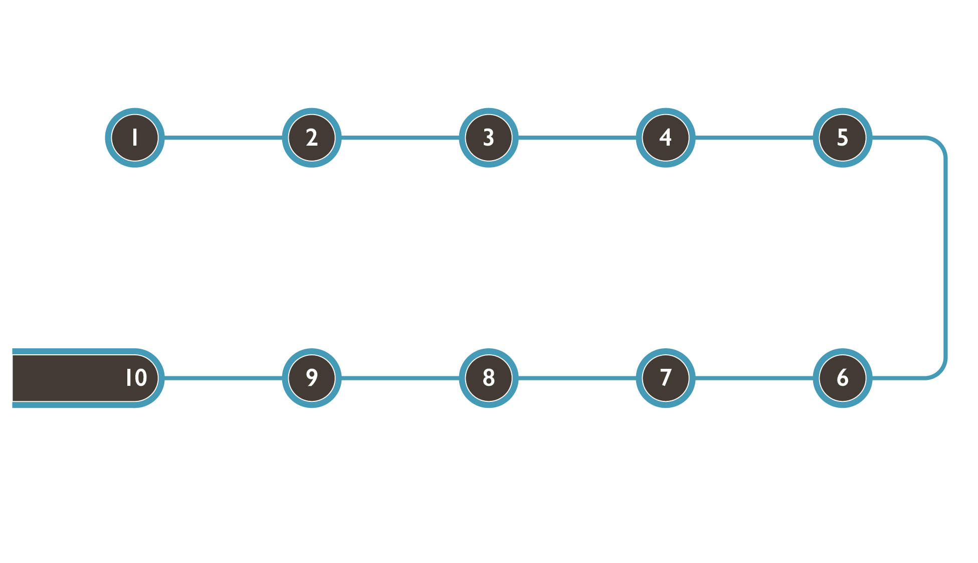
The IA-APP Process At A Glance
Ministry of Agriculture (CAADP focal point, Agricultural Sector Working Group or designate) reviews/adapts IA-APP Process Facilitator Statement of Work and identifies an appropriate candidate.
Multi-sectoral Steering Committee is convened and confirms SC composition. Terms of Reference are agreed.
Steering Committee conducts an IA environmental scan, determines whether additional analyses are needed and agrees objectives of IA-APP process.
Steering Committee uses stakeholder mapping to identify workshop participants to represent stakeholder groups.
Steering Committee adapts workshop invitation template sends invitations to participants.
Steering Committee periodically meets to monitor implementation of the IA Improvement Plan.
Steering Committee presents IA Improvement Plan to key stakeholders and ensures integration and harmonizing of plan with other workplans and processes.
An After Action Review is held and the IA Improvement Plan is finalized.
IA-APP workshop is held and an IA Improvement Plan is drafted.
Workshop materials (agenda, slide deck, assessment instrument, improvement plan template etc.) are adapted and logistics are agreed.

Slide 5
Ministry of Agriculture reviews/adapts IA-APP Process Facilitator Statement of Work and an appropriate candidate
STEP 1
To get started, the CAADP focal point or an Agricultural Sector Working Group at the Ministry of Agriculture undertakes to identify an IA-APP Process Facilitator. The process facilitator is a person skilled in using participatory approaches for multi-stakeholder processes who will work closely with the Steering Committee to plan, carry out and follow-up on the IA-APP process.
The CAADP focal point or an Agricultural Sector Working Group at the Ministry of Agriculture reviews and adapts the Statement of Work which includes:
Background of the IA-APP process
Tasks related to supporting the Steering Committee in formation and decision-making
Tasks related to IA-APP workshop preparation and facilitation
Follow-up support to the SC in finalizing the IA Improvement Plan and presenting it to key stakeholders
Requisite experience and skills

Slide 6
Multi-sectoral Steering Committee is convened and confirms SC composition. Terms of Reference are agreed.
STEP 2
Once the IA-APP process facilitator is in place, the Ministry of Agriculture or the Prime Minister’s Office determines the composition of the Steering Committee. It is important the steering committee include multisectoral representatives of food security, including:
Government agencies responsible for agriculture and nutrition,
Civil society, including academic and media
Private sector, including professional associations
The facilitator aids the Steering Committee to coalesce as a team through team building and knowledge sharing activities. Together the Steering Committee explores the concept of Institutional Architecture and the IA Framework.
They review, adapt and agree the Terms of Reference included in the toolkit.

Slide 7
Multi-sectoral Step 3: Steering Committee conducts an IA environmental scan, determines whether additional analyses are needed and agrees objectives of the IA-APP process.
STEP 3
To inform the objectives and planning of the IA-APP process, the Steering Committee undertakes an environmental scan of their Institutional Architecture for food security. Conducting the scan together enables the Steering Committee to quickly capture known information and identify what further information or analyses might be needed to best target the IA-APP process.
The IA Steering Committee Environmental Scan in the toolkit proposes a series of questions for the Steering Committee to consider that cover pressing food security and nutrition issues, influencers of these issues, points of contacts for stakeholder group, NAIP implementation and IA strengths and weaknesses.
Where the Steering Committee identifies gaps in available information, it makes arrangements to obtain that information as needed. Once all pertinent information is available, the Process Facilitator aids the Steering Committee to agree on specific objectives for the IA-APP process.

Slide 8
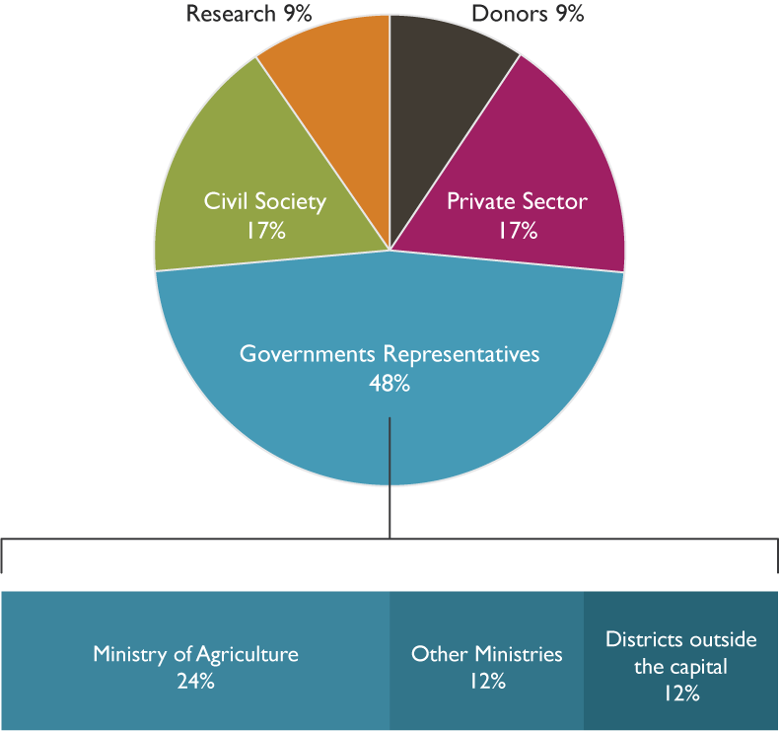
Multi-sectoral Steering Committee uses stakeholder mapping to identify workshop participants to represent stakeholder groups.
STEP 4
In order to ensure key stakeholder groups are represented at the IA-APP workshop, the Steering Committee conducts stakeholder mapping. There are many available stakeholder mapping tools including one that is provided in the toolkit that can be facilitated by the Process Facilitator.
As a result of the stakeholder mapping, the Steering Committee will have a comprehensive view of all key stakeholders and be better able to identify workshop participants. The diagram at the right shows the recommended participant list composition reflecting government, civil society, farmers, private sector, academia, media and development partners.

Slide 9
Steering Committee adapts draft workshop invitations and sends invitations to participants.
STEP 5
The Steering Committee reviews and adapts the invitation template in the toolkit.
Once the invitations are sent, Steering Committee members follow up with specific invitees to ensure they:
Receive the invite
Stakeholders understand the purpose of the process
Are able to attend
Receive necessary background materials

Slide 10
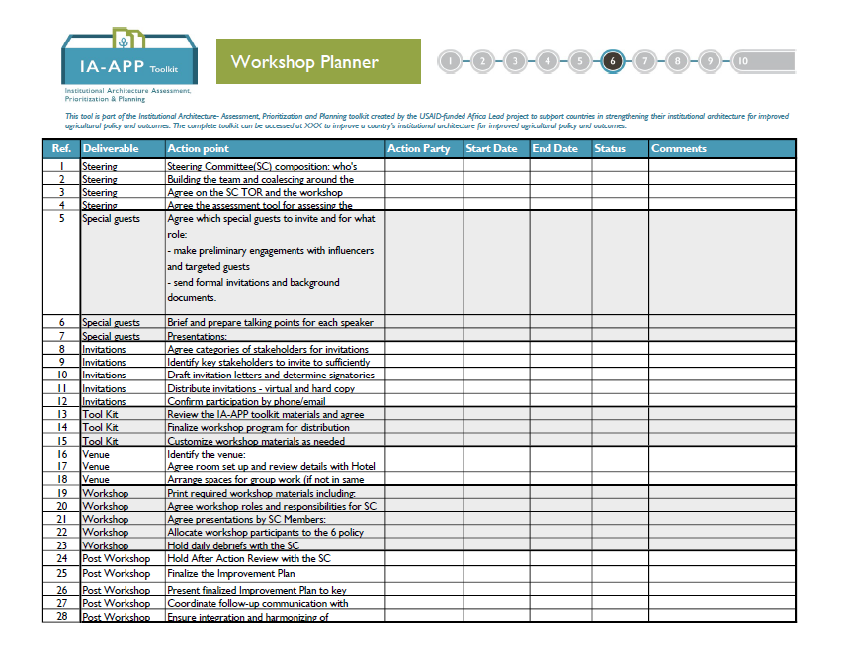
Workshop materials are adapted; venue is identified, and logistics are agreed.
STEP 6
STEP 6
At this point, the Process Facilitator works with the Steering Committee to review and adapt the various workshop materials included in the toolkit including:
Workshop agenda
Workshop presentation
IA survey instrument
Improvement plan template
Proposed action feedback form
Workshop evaluation
The facilitator also works with the Steering Committee to identify an appropriate venue and logistics to support the workshop.
The workshop planner can be used to clarify and track workshop-related tasks.

Slide 11
IA-APP Workshop is held and an IA Improvement Plan is drafted.
STEP 7
The IA-APP workshop is held over 3 days culminating in an IA Improvement Plan. Overall, the workshop aims to create an inclusive and participatory environment to achieve the following broad objectives augmented by specific objectives surfacing from the IA environmental scan:
Build a shared understanding of institutional architecture (IA) and its link to food security, the National Agricultural Investment Plan (NAIP), Joint Sector Reviews (JSR), and the CAADP Biennial Review (BR) processes;
Assess the strengths and weaknesses in the institutional architecture for food security;
Prioritize areas for the improvement of the institutional architecture for food security; and
Reach broad consensus on an IA Improvement Plan.
The workshop is facilitated by the IA-APP Process Facilitator with support from Steering Committee members who serve as facilitators of small group activities, encourage balanced participation of all stakeholder groups and ensure key outputs are captured.

Slide 12
An After Action Review is held and the IA Improvement Plan is finalized.
STEP 8
Following the IA-APP workshop, the Process Facilitator conducts an After Action Review (AAR) with the Steering Committee. The AAR is intended to consolidate and concretize key outcomes from the workshop and foster collective learning.
Discussions from the AAR are also used to aide the Steering Committee in finalizing the IA Improvement Plan.
The AAR agenda in the toolkit can be adapted by the facilitator and Steering Committee as needed to respond to specific learning needs and time available.

Slide 13
Steering Committee presents finalized IA Improvement Plan to key stakeholders and ensures integration and harmonizing with other workplans and processes.
STEP 9
The Steering Committee presents the IA Improvement Plan to key stakeholders including partnering ministry representatives, private sector representatives and donor groups in order to socialize the plan and garner needed support for implementation.
These presentations are an opportunity to jointly determine how actions included in the IA Improvement Plan can be integrated and harmonized with other workplans and processes, thereby also leveraging available resources.
During these meetings, the Steering Committee also shares plans for monitoring the progress of plan implementation and seeks to engage partners in periodic pause and reflect activities.

Slide 14
Steering Committee periodically meets to conduct Stocktaking to monitor implementation of the IA Improvement Plan.
STEP 10
Ensuring progress toward achievement of the IA Improvement Plan can be supported by periodic pause and reflect activities by the Steering Committee. Conducted every 2-3 months, these activities are intended to enhance strategic collaboration and stakeholder engagement, strengthen knowledge transfer and learning and/or adjust practices and to enable adaptive management.
One example of a pause and reflect activity that the Steering Committee can use is Stock-taking. This activity allows Steering Committee members to:
Reflect on how contextual changes and results to date confirm or challenge core assumptions of the IA Improvement Plan
Confirm that implementation of projects and activities supports the Improvement Plan, and
Determine whether the components can be better aligned to improve results.
Stock –taking includes reviewing cumulative progress toward achievement of the IA Improvement Plan and the status of critical assumptions, risks, and changes in context, along with related implications for performance. Based on the results of the stock-taking activity, the Steering Committee determines what, if any, actions are needed to course correct and further IA Improvement Plan implementation.

Slide 15
Tracking Change Over Time
Used annually, the IA-APP process can support consistent engagement of key stakeholders in policy development and implementation toward improved policy outcomes.
Pause and reflect activities implemented throughout the year following the IA-APP workshop can support the Steering Committee in monitoring implementation of the IA Improvement Plan.
For countries planning to conduct the IA-APP process for a consecutive year, it is recommended to include review and discussion of the previous year’s assessment results in comparison with the current year’s results during the IA-APP workshop. A few questions for consideration include:
Where can improvements in the institutional architecture be seen?
Where do weaknesses persist?
To what extent did implementation of the previous year’s IA Improvement Plan impact assessment scores this year?

Slide 16
More questions about the IA-APP Process?
Contact us and let us know how we can help.
IA-APPHelpdesk@dai.com

Slide 17
IA Capacity Building Resources
Africa Lead website: https://www.africaleadftf.org/
Systems Mapping Tool by Kumu
USAID Learning Lab, Thinking and Working Politically (TWP) through Applied Political Economy Analysis (PEA): Core Resource Documents, June 2018

